Slide 1
COMPUTER FUNDAMENTALS
.
A 1.2.3 Logic Gates

Slide 2
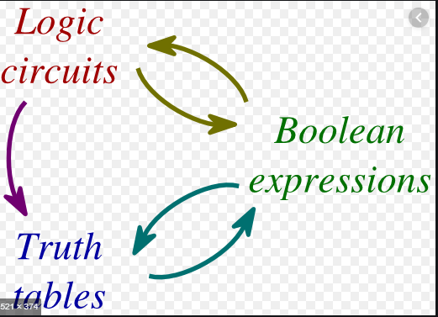
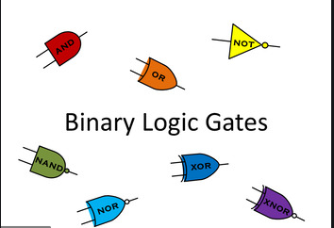
Unit 2- Logic Gates and circuits

Slide 3


success criteria
Lesson objective
To learn basic logic gates
To identify gates using different symbols
Create Truth Table
All should be able to define different logic gates
Some would be able to create truth tables using 2 and three inputs
Few would be able to apply logic gates for equations
ATL–
Collaboration, Critical thinking, Curiosity, Creativity, Communication, Confidence
HOT Question – Higher Order Thinking
Applications in Real Life

Slide 4
Starter ( 2House Points)
What do you understand by Logic?
What do you understand by Logic gate?
How can you relate binary to logic gates?
https://www.youtube.com/watch?v=Sc3lh3D4rCw

Slide 5
Logic Gates
Logic Gates
Basic
Universal
Exclusive
NOT
AND
OR
NAND
NOR
EX-OR
EX - NOR

Slide 6
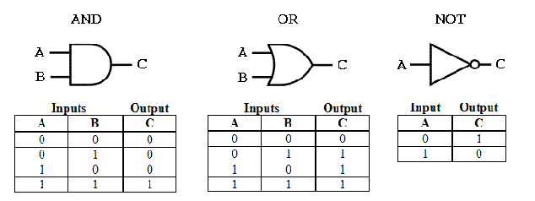
Basic Gates

Slide 7
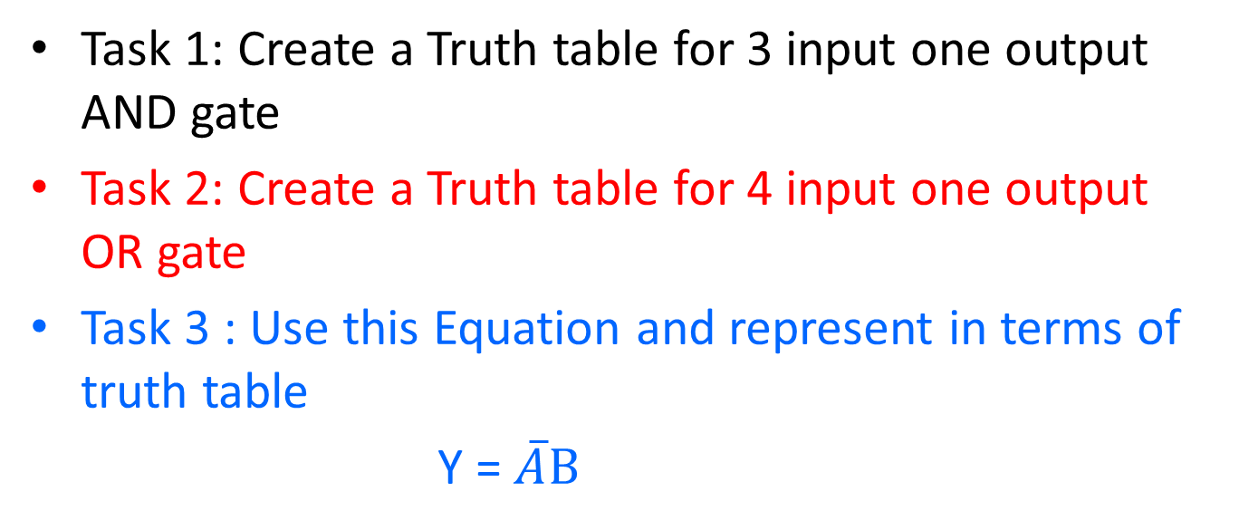
Differentiated Activities

Slide 8
Part 4 - Plenary – Progress check
Importance of Logic circuits
Creating truth table
Verifying facts using Truth table

Slide 9
Success Criteria
Lesson objectives (WALT)
To learn different universal logic gates
To identify gates using different symbols
Create Truth Table
To understand Demorgan’s Theorem
All should be able to define different logic gates
Some would be able to create truth tables using 2 and three inputs
Few would be able to apply logic gates for equations and merge Basic gates and Universal gates
Competency Link –
Collaboration, Critical thinking, Curiosity, Creativity, Communication, Confidence
HOT Question – Higher Order Thinking
Applications in Real Life

Slide 10
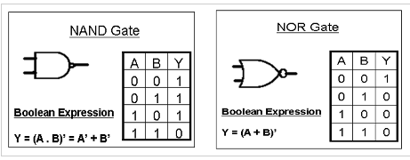
Universal Gates

Slide 11
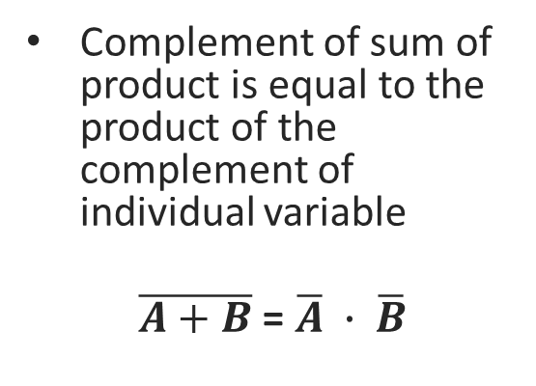
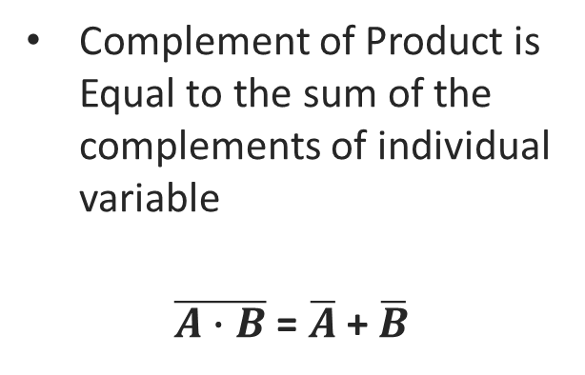
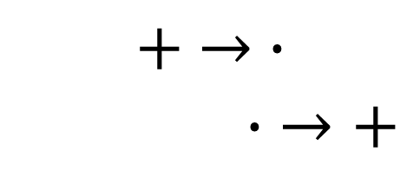
De Morgan’s Theorem
Theorem 1
Theorem 2

Slide 12
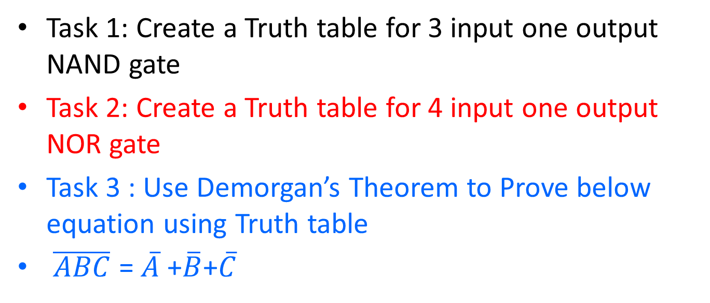
Differentiated Activities

Slide 13
Part 4 - Plenary – Progress check
Application of Universal Gates
Using De morgans theorem to solve Different equations
Truth table use cases for verification

Slide 14
Success Criteria
Lesson objectives (WALT)
To learn different exclusive logic gates
To identify gates using different symbols
Create Truth Table
To Prove NAND and NOR as universal gate
All should be able to define different logic gates
Some would be able to create truth tables using 2 and three inputs
Few would be able to solve Boolean equation using truth table facts
Competency Link –
Collaboration, Critical thinking, Curiosity, Creativity, Communication, Confidence
HOT Question – Higher Order Thinking
Applications in Real Life

Slide 15
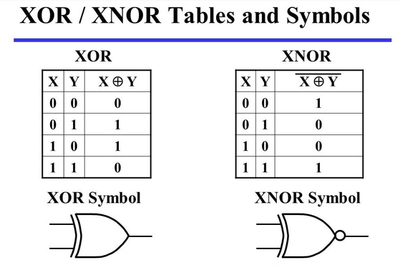
Exclusive Gates

Slide 16
Differentiated Activities
Task 1: Create a Truth table for 3 input one output EX OR gate
Task 2: Create a Truth table for 4 input one output EX NOR gate
Task 3 : Design EX OR gate using basic gates only

Slide 17
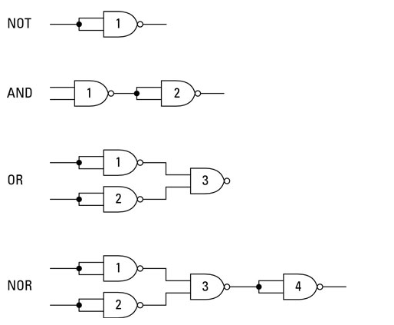
Prove NAND as Universal Gate

Slide 18
Challenge Task (THINK – PAIR – SHARE)
Prove NOR gate as Universal Gate and even create Truth table for the same.

Slide 19
Part 4 - Plenary – Progress check
QUIZ
https://tinyurl.com/yxzf5ur6

